Slide 1
CYBER SECURITY AND ARTIFICIAL INTELLIGENCE FOR CLOUD- BASED INTERNET OF TRANSPORTATION SYSTEMS

Slide 2
ABSTRACT
The "Cyber Security and Artificial Intelligence for Cloud-Based Internet of Transportation Systems" initiative combines cyber security, artificial intelligence, and cloud technology to enhance data integrity and user safety in interconnected transportation networks.
In the previous development, IOT is been used to store the data which will be transferred to autonomous vehicle. But this system have some drawbacks regarding security during data transfer.
The project uses CPABE encryption to secure files during upload, storage, and download.
Through distinct user and cloud server modules, it enables seamless interaction, encryption, and decryption while maintaining file integrity.
The project integrates AI-driven anomaly detection and robust cyber security measures, safeguarding cloud-based transportation systems against emerging threats.

Slide 3
INTRODUCTION
In the rapidly advancing landscape of technology, the integration of artificial intelligence (AI) and cyber security has become imperative, especially within the cloud-based Internet of Transportation Systems (IoTs).
As transportation systems become more interconnected and reliant on cloud infrastructure, the need to fortify these networks against cyber threats become paramount.
The introduction explores the intersection of AI and cybersecurity in the context of cloud-based IoTs, highlighting the significance of safeguarding transportation systems in an era of digital transformation.

Slide 4
PROBLEM STATEMENT
Intelligent Internet of Transportation Systems can be made by putting together artificial intelligence, cloud computing, cyber security, and the storage of data.
Social media platforms can be affected by both AVs and cyberattacks. This could put the privacy of social media users and the information they share at risk.
Cloud computing also poses some challenges for IoT applications, such as latency, bandwidth, reliability, and interoperability. Latency means the delay between sending and receiving data, which can affect the performance and responsiveness of IoT devices and applications.

Slide 5
OBJECTIVE
The primary objective is to enhance the cybersecurity framework of the cloud-based Internet of Transportation Systems (IoTs) integrated with artificial intelligence.
It also uses CP-ABE encryption method so that only authorized users can view the message. This includes:
Strengthening data protection: means implementing robust encryption and access controls to safeguard sensitive information.
Ensuring system reliability: means developing measures to prevent disruptions and downtime caused by cyber threats.
Enhancing AI resilience: Implementing defenses against adversarial attacks on AI algorithms used in transportation systems.
Continuous monitoring and adaptation: Establishing mechanisms for real-time threat detection and response to evolving cyber risks.

Slide 6
EXISTING SYSTEM
The existing system faces significant cybersecurity vulnerabilities within its cloud-based internet of Transportation Systems (IoTs).
Weakness includes potential data breaches, system disruptions, and the susceptibility of AI algorithms to exploitation. These challenges compromise the integrity and safety of transportation networks, necessitating a comprehensive reassessment of the current security measures to fortify against evolving cyber threats in the rapidly advancing technological landscape.

Slide 7
DRAWBACKS OF EXISTING SYSTEM
Vulnerable to security breaches.
Risks associated with improper data transfers.
Increased susceptibility to cyber attacks and unauthorized access.

Slide 8
PROPOSED SYSTEM
In proposed system we are implementing Cyber Security (CS) based data transfer to Autonomous vehicle to overcome the existing problems. Here a cloud is the mediator that which transfers sender files to autonomous vehicle with more security we are using CP-ABE based algorithm which is used to hide the transferred data into cipher text. The cipher text can be decrypted by the private key generated by sender to the particular AV.

Slide 9
BENEFITS OF PROPOSED SYSTEM
Enhanced security measures bolster protection against breaches, ensuring robust defenses against unauthorized access and data compromise.
Precision in data transmission minimizes errors, optimizing reliability and promoting seamless, accurate information exchange.
Reduced cyber attack susceptibility through proactive measures fortifies systems, safeguarding against threats and enhancing overall digital resilience.

Slide 10
REQUIREMENTS
SOFTWARE
HARDWARE
1) FRAME WORK - FLASK/DJANGO
2) DATABASE - MYSQL WORK BENCH/SQLITE 3
3) USER INTERFACE LANGUAGES - HTML, CSS, JS, BOOTSTRAP 4
4) FRONTEND LANGUAGES - PYHTON
5) SOFTWARE INSTALLED - PYTHON IDLE (3.7.0)
1)Operating System : Windows Only
2)Processor : i5 and above
3)Ram : 8gb and above
4)Hard Disk : 25 GB in local drive

Slide 11
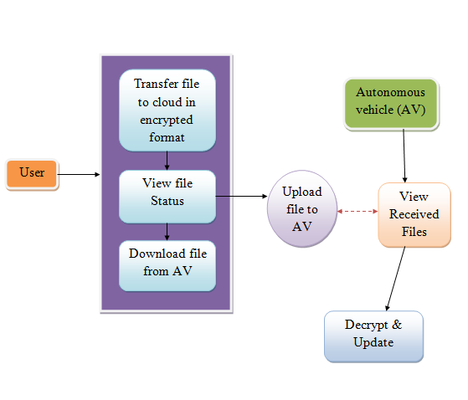
SYSTEM ARCHITECTURE

Slide 12
CONCLUSION
Intelligence for Cloud-based Internet of Transportation Systems" successfully bridges the realms of cutting-edge technology and security in modern transportation networks.
By synergizing AI-driven anomaly detection and robust cyber security measures, the project contributes to safeguarding cloud-based transportation systems against emerging threats.
Continuous monitoring, adaptation, and collaboration are vital components in this evolving landscape.
Safeguarding transportation networks through comprehensive cybersecurity measures not only protects sensitive information but also contributes to the sustained efficiency and safety of advancement and interconnected systems.

